Slide 1
Accessibility Status of Sakai CLE and OAE
Joe Humbert, Indiana University
Brian Richwine, Indiana University

Slide 2
Sakai Accessibility Working Group (AWG)
Who we are and what we do

Slide 3
Who are the AWG
Volunteers from participating universities and companies
Most Active Members:
Jane Berliss-Vincent, University of Michigan (UMich)
Eli Cochran, UC Berkley
Joe Humbert, Indiana University (IU)
Brian Richwine, IU
Gonzalo Silverio, UMich
Mary Stores, IU
Scott Williams, UMich

Slide 4
What the AWG does
Provide accessibility consulting to the Sakai Community
Performs accessibility reviews
Tracks accessibility issues (+ writes JIRAs)
Works to resolve issues
Writes accessibility documentation

Slide 5
Sakai’s Accessibility Goals
What we hope to achieve

Slide 6
The Goal is Accessibility
Problem:
What does it mean for Sakai to be accessible?
What are we striving for?
How do we know when we’ve done it?
Answer:
Accessibility Statements
http://www.sakaiproject.org/accessibility

Slide 7
Sakai’s Accessibility Goals
Meet World Wide Web Consortium (W3C) Web Accessibility Initiative (WAI) Web Content Authoring Guidelines (WCAG) 2.0 Level AA Compliance
Use of WAI Accessible Rich Internet Applications (ARIA) Technologies where appropriate
Meet W3C Authoring Tool Accessibility Guidelines (ATAG) Compliance

Slide 8
Sakai Collaboration and Learning Environment Accessibility
Lessons learned

Slide 9
Sakai 2.9 Review
Inaccessible technologies can be hard to replace:
Widgets (like What You See Is What You Get [WYSIYG] / Rich Text Editors)
Scripting technologies (JavaServer Faces [JSF])
Legacy Libraries

Slide 10
Sakai 2.9 Review
New or updated User Interfaces (UI) pieces are likely to repeat many basic of accessibility coding errors:
Many developers don’t know or are not using even the basic accessibility coding patterns
Developers and Quality Assurance (QA) testers are not knowledgeable of how to screen for accessibility issues

Slide 11
Sakai 2.9 Review
Accessibility issues can easily slip into a release:
Accessibility Working Group has limited resources and can’t test everything
Accessibility Working Group is not always aware of new or updated features
Accessibility reviewer not always knowledgeable of how to fully exercise a tool
By the time the accessibility review starts, it can be too late to get the fixes into the release

Slide 12
Sakai 2.9 Review
Technology Limitations:
Accessibility evaluation tools aren’t always up to the challenge
End user Adaptive Technology (like screen reading software) isn’t always up to the challenge
Changes in Adaptive Technology software behavior catches us by surprise

Slide 13
Sakai 2.9 Review
Sakai CLE 2.9 Accessibility Highlights:
Sakai Accessibility Working Group Performed 42 individual reviews
CKEditor WYSIWYG editor on by default
Many other keyboard accessibility issues resolved
ARIA Landmarks added
Experimenting with ARIA Live Update Regions
2.9 is the most accessible CLE release to date
CLE release team is committed to fixing all the critical accessibility issues that have been identified

Slide 14
Sakai Open Academic Environment Accessibility Status
What we discovered and our recommendations

Slide 15
OAE v1.1 Review
Conducted from February 23rd, 2012 through May 10th, 2012.
6 participating reviewers
4 different types of adaptive technology used plus keyboard only testing
31 unique reviews of 14 different functional areas
Results complied into summarized report

Slide 16
OAE v1.1 Review Results
4 Critical or Blocker accessibility issues
Failure to meet 21 of 37 WCAG 2.0 success criteria
Top Accessibility issues are prevalent in all areas of Sakai OAE
Redeveloped features and widgets in future versions display the same accessibility issues
Notes:
Critical and blocker issues were found in content authoring functional area

Slide 17
Improvements Since v1.1
18 Jiras patched and verified for v1.2 and v1.3
Improvements to the following areas:
Keyboard focus
Skip Navigation
Labeled previously unlabeled form controls
Heading structure
Non-unique or descriptive HTML links
Color as the only means of conveying information
Even more accessibility improvements are being added to v1.5 release

Slide 18
AWG Recommendations for OAE
Require that all developers have a basic level of understanding in accessibility evaluation, design and development techniques, and provide training for developers who do not meet this requirement.
Develop a semantic affordance style guide that includes accessible design and development patterns.

Slide 19
AWG Recommendations for OAE
Create a developers’ checklist distilled from the WCAG 2.0 success criteria and ATAG and supplemented by the semantic affordance style guide.
Develop testing protocols for newly developed widgets and functional areas that automatically validate (where possible) against the WCAG 2.0 success criteria.

Slide 20
AWG Recommendations for OAE
Incorporate accessibility testing and the semantic affordance style guide into the Quality Assurance testing phase to identify accessibility issues before a version release.
Include accessibility experts in the design and requirements gathering phases of new and redesigned features, so that potential accessibility considerations may be addressed.

Slide 21
AWG Recommendations for OAE
Develop an accessibility roadmap and, if needed, accessible alternatives so the general public is aware of the accessibility status and remediation efforts.

Slide 22
OAE v1.1 Review Report
The full evaluation results are available at:
http://tinyurl.com/A11yOAEv1-1
The entire Sakai OAE v1.1 Accessibility Evaluation Report is available at:
http://tinyurl.com/OAEv11Report

Slide 23
Top Accessibility Issues
What is holding users back

Slide 24
Keyboard Accessibility
Clickable HTML elements that cannot receive keyboard input or visual focus.
Content areas that trap keyboard focus so keyboard-only users cannot easily navigate away from the area.
HTML elements that do not display adequate visual indication of focus.
HTML elements received focus in an order that does not match the visual layout.
Notes:
Talk about the types of clickable elements (opening widgets, adding content, selecting items, etc)

Slide 25
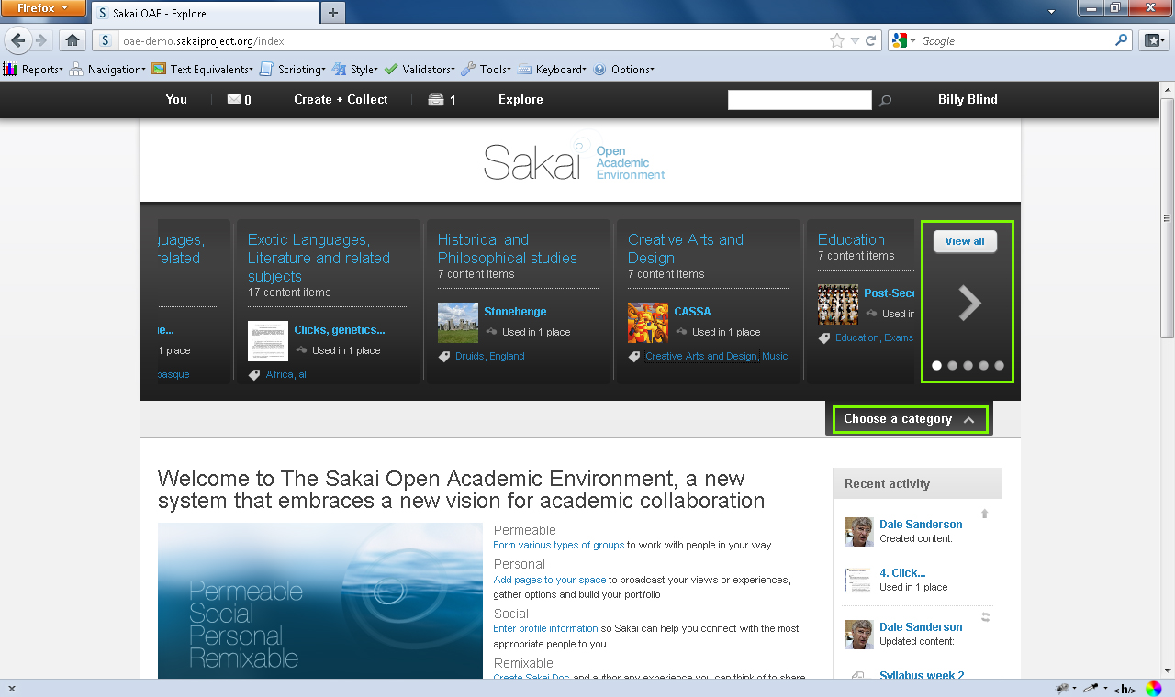

Slide 26
Semantics
Inadequate or missing heading structure for important areas of each page
Groups of links or content not marked up as HTML lists
Non-unique page titles
Form controls that are not uniquely and explicitly labeled
Missing Skip navigation or skip to content links

Slide 27
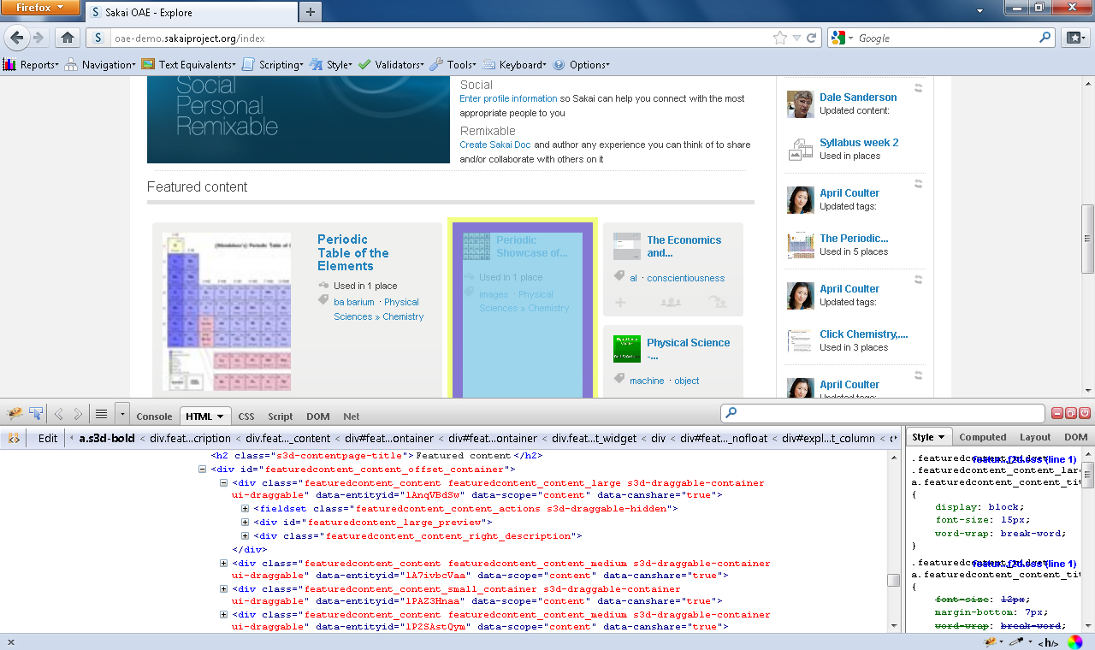

Slide 28
HTML links
Widespread use of links that are not unique or that do not describe the purpose of the link
Example: 2 Content Items

Slide 29
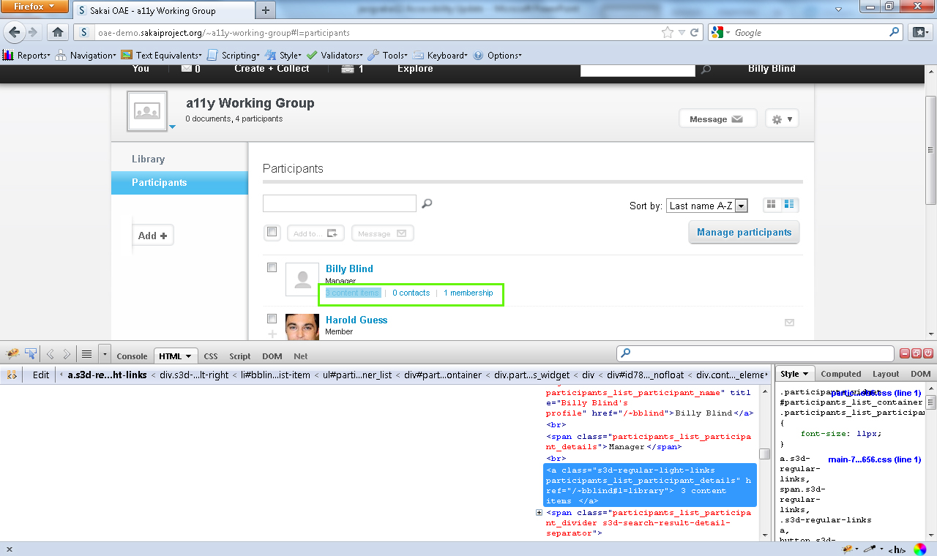

Slide 30
Alternative Text Descriptions
Images missing alternative text descriptions
Images with inadequate or incorrect alternative text
Example: profile picture
Images with redundant alternative text.
Example:
Thumbnail image alt text: Sample.pdf following link: Sample.pdf

Slide 31
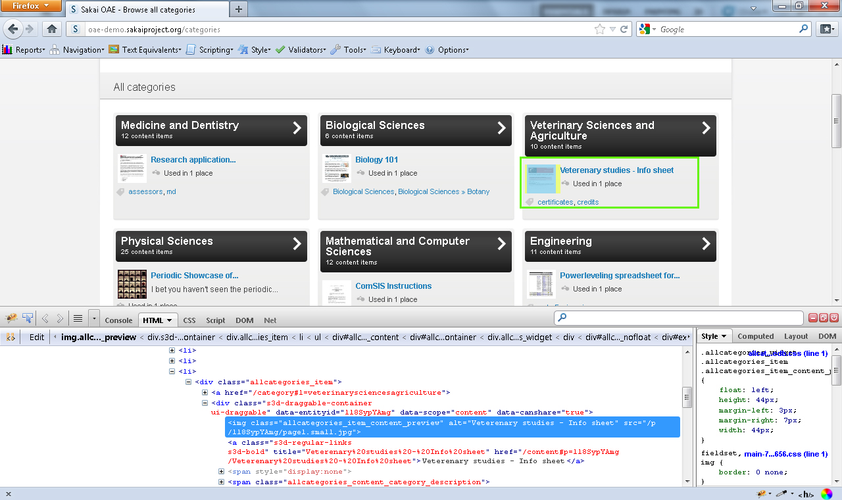

Slide 32
Color Contrast
Numerous UI elements do not meet the minimum color contrast ratio of 4.5:1
Equation: (L1 + 0.05) / (L2 + 0.05)
L1 is the relative luminance of the lighter of the colors,
L2 is the relative luminance of the darker of the colors.
The relative brightness of any point in a colorspace, normalized to 0 for darkest black and 1 for lightest white

Slide 33
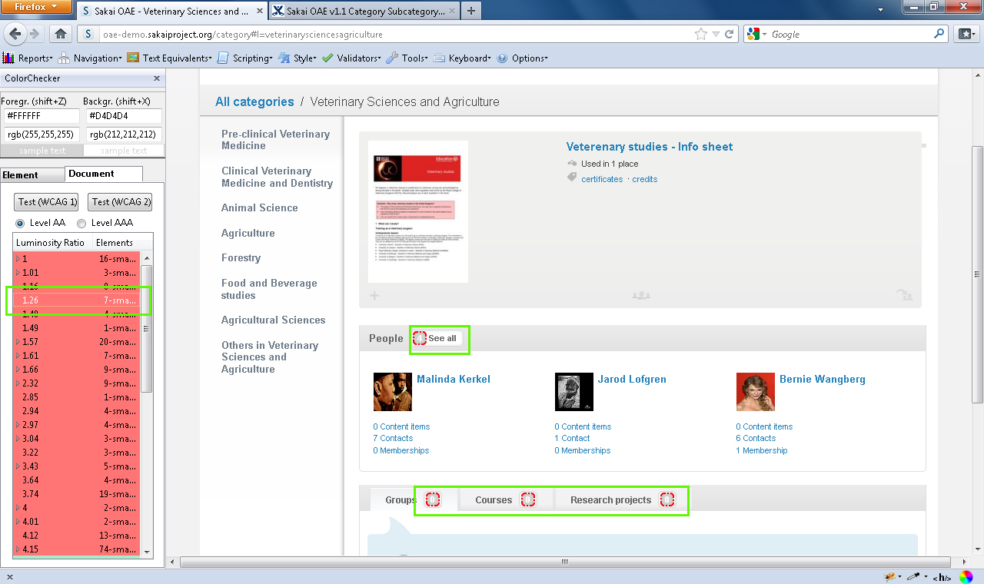

Slide 34
User Control of Updates
Users have limited control of updated content
Content is constantly changing or being updated
Example
Sakai OAE recent activity feed is updated every 30 seconds
Sakai OAE My dashboard has a suggested content area that updates every 30 seconds
Users should always be provided with a mechanism to stop an update.

Slide 35
Flash video outside of PowerPoint

Slide 36
Contextual Meaning
Important information is conveyed to users only through visual context and not through semantic structure
Example
My messages (1)
Coding
<div class="lhnavigation_item_content"> <div class="lhnavigation_has_subnav lhnavigation_has_subnav_opened"></div> <div class="lhnavigation_levelcount">1</div> <a class="s3d-bold lhnavigation_toplevel lhnavigation_toplevel_has_subnav lhnavigation_toplevel_link" href="#l=messages/inbox" role="menuitem">My messages</a> </div>

Slide 37
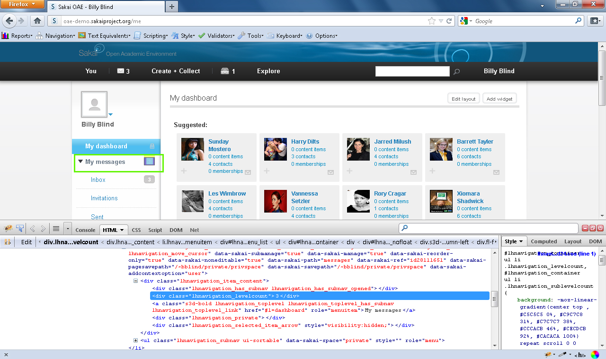

Slide 38
Help Documentation
In Sakai OAE, It would benefit users if there was better help documentation for end users.
Context sensitive help for each functional area
Accessibility specific help for that same functional area

Slide 39
Sakai Accessibility Roadmaps
Where we need to go and how we get there

Slide 40
Draft OAE Accessibility Roadmap
Develop semantic affordance style guide and developers’ checklist within 3 months
Meet all WCAG 2.0 level A success criteria before v2.0
Meet all WCAG 2.0 Level AA success criteria before v2.5
Address keyboard accessibility issues before v1.6
Include accessibility documentation in v1.5
Incorporate accessibility testing and semantic affordance style guide into QA processes for v1.5 release
Notes:
This will need to be discussed with key OAE stakeholders and decide on how it will be accomplished

Slide 41
Join the fun…
How you can get involved

Slide 42
How You Can Help
Share your knowledge of accessibility concerns with using / administering Sakai
Share your knowledge of how best to support users with disabilities in using Sakai
Let us know which features and tools are important to you
Help perform accessibility reviews
Help resolve accessibility issues
Help write documentation

Slide 43
How to Get Involved
Join the WG’s email list:
accessibility@collab.sakaiproject.org
Sign up or view the archives by visiting this page:
http://collab.sakaiproject.org/mailman/listinfo/accessibility

Slide 44
How to Get Involved
Call in for our bi-weekly teleconferences
How to connect:
Dial: (812) 856-7060
Conference Code: 22348#
An agenda for each meeting is mailed out to the group’s email list.

Slide 45
How to Get Involved
Sakai Accessibility Working Group Website
http://tinyurl.com/Sak-A11y
Or simply Google “Sakai Accessibility Working Group”

Slide 46
Thanks for the help
Credit where credit is due

Slide 47
Thanks to the Sakai Community
Sakai CLE
Adrian Fish
Charles Severance
Sam Ottenhoff
Matthew Jones
Greg Thomas
Gonzalo Silverio
Noah Botimer
Matthew Buckett
Zhen Qian
David Haines
David Roldán Martínez
Jean-François Lévêque
Savitha Prakash
Charles Hedrick
Sean Keesler
Sakai OAE
Kent Fitzgerald
Eli Cochran
Anthony Whyte
Gonzalo Silverio
James Sloane
Bert Pareyn
Christian Vuerings
Nicolaas Matthijs

Slide 48
Shameless Self-promotion
Come join us for our Birds of a Feather session
Accessibility and Innovative Design
Wednesday 2:30-3:30pm
Tower 1401
Topics:
Increasing participation in AWG
Discuss best practices of WAI ARIA
Adaptive Technology demonstrations
Work with accessibility experts to evaluate your work for accessibility issues
Pick our Brains

