Slide 1
Sakai Teaching & Learning Update
December 9, 2010

Slide 2
Agenda
Welcome and process update (Josh Baron)
Initiative updates
Teaching with Sakai Innovation Award (Rob Coyle)
Learning Capabilities Design Lenses (Lynn Ward)
Student Engagement in the Community (Josh Baron)
Distance Learning (Rob Coyle)
Wrap Up and Final Questions

Slide 3
Brief History on T&L Sakai Group
Early community seemed to be missing a T&L voice
“Community Gathering” at Newport Beach (2007)
Core group of 8 -10 people emerged
T&L Group initially focused on TWSIA Award
Now entering it’s 4th year!
Learning Capability Design Lenses
Major focus during the 2009-10 time period
We have now expanded into four working groups
Work cycle tied to conference has emerged

Slide 4
Current Activities and Processes
Flowing from Denver Conference (2010)
Expanding TWSIA program
Applying Learning Design Lenses to Sakai OAE
Distance Learning
Student Engagement in the Community
Sub-Groups have formed around each of these
Weekly or bi-weekly calls
Monthly “Whole Group” calls
Quarterly Community Updates
Confluence pages for each group

Slide 5
Teaching with Sakai Innovation Award
2011 Chair Rob Coyle, Johns Hopkins University
2011 Co-Chair Sue Roig, SunGard Higher Education

Slide 6
About the TWSIA Award
4th Annual Award to be given at Denver 2011 Conference
International Award Open to All Accredited Institutions
To Promote good pedagogy and innovation in teaching and leaning (with technology)
Sharing teaching and learning practices
Increase faculty and student involvement in Sakai Community

Slide 7
2011 TWSIA Initiatives
Expanding the Award to reflect more of Sakai community:
K-12 (Primary and Secondary Ed)
Fully Online/Hybrid Courses
Non-Traditional/Non-Course Sites (Projects, Portfolio, Student Sites)
Traditional Higher Ed (Including all F2F and Web-Enhanced)
Revised Definition of Innovation for the Award
Added concepts of teaching excellence, engagement, design.
Worked carefully on internationalization of language in definition and in all areas of award.

Slide 8
2011 TWSIA Initiatives
Revised our Evaluation Rubric
Refined to include student engagement and innovation
Revised our Judging Process to reflect new categories and to rotate in new judges
Reworked our Sponsorship Module
Sponsors for 2011: IBM Corp., rSmart, Wiley and Sons
Raised more funding this year than any previous year
Expanded Presence on OpenEdPractices.org

Slide 9
Current Activities - TWSIA
Advertising the Award
Accepting Entries
Preparing for the Preliminary Judging Process
Deadlines:
Announced: October 12 at EDUCAUSE
Entries Opened: November 10th
Applications Accepted Until: February 7, 2011
Preliminary Judging: Feb 2011
Final Judging: May 2011
Winners Announced: early April 2011

Slide 10
Getting Involved in TWSIA
Ways to Be Involved
How to Get Involved
Spread the Word
Preliminary Judges
Join the Committee Mtgs
Apply for the Award
Meetings:
Every Thursday12:00pm EST, currently Ad Hoc till January.
Email:
http://collab.sakaiproject.org/mailman/listinfo/twsia
More Information:
http://openedpractices.com/twsia
http://bit.ly/twsia11
Contact Directly:
Rob Coyle (rcoyle@jhu.edu)

Slide 11
TWSIA Questions ?

Slide 12
Learning Design Lenses
Chair, Lynn Ward, Indiana University

Slide 13
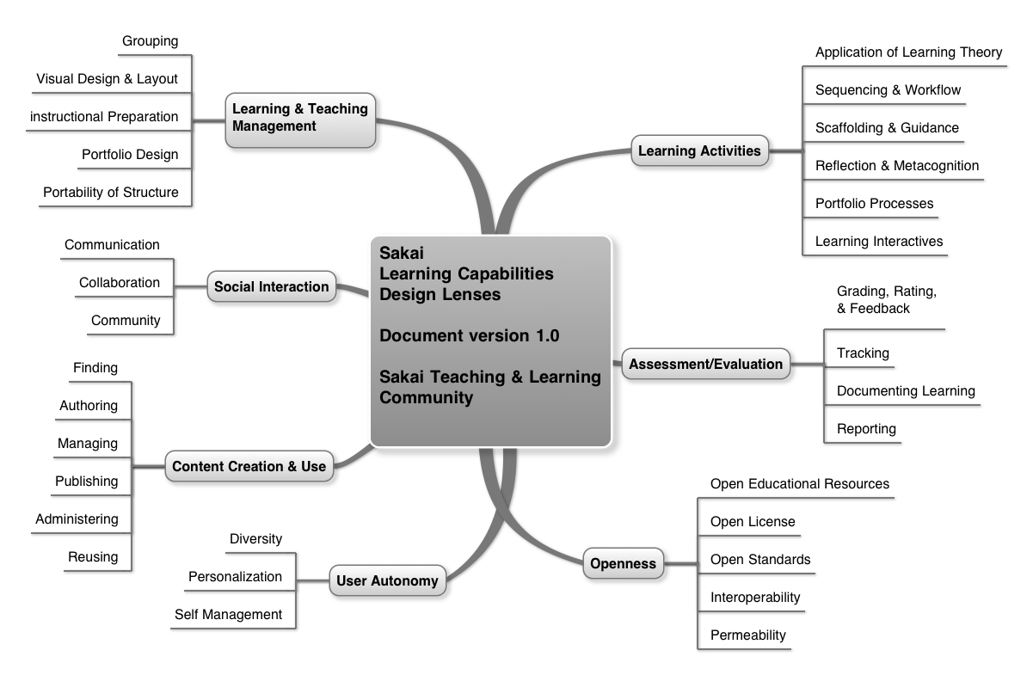
About the Learning Design Lens Group
Core group that worked on Sakai Learning Capabilities and Design Lenses last year
Learning Design Lenses 1.0 have now been incorporated into Sakai OAE Road Map
Group has begun to broaden effort by engaging with Sakai OAE design effort:
Fireside Chats
OAE User Reference Group
Sakai Design Lens Call

Slide 14
Current Design Lens Activities
Have established a regular weekly process
Sakai OAE Managed Project Team identifies minispecs or topics
Group reviews minispec and posts comments to Confluence
Weekly call to discuss further facilitated by OAE design team members
Future work may include:
Wireframes and provide feedback to designers
Want to return to Lenses work at some point
New name? Teaching & Learning Reference Group??

Slide 15
Getting Involved
Ways to Be Involved
How to Get Involved
Sign up for mailing list and start attending Lenses meetings
Read meeting assignments, dig in, and share comments and questions
Meetings:
Mondays @ 5pm Eastern (except weeks with 2nd Wednesdays)
Email: http://collab.sakaiproject.org/mailman/listinfo/tl-lenses
More Information: http://confluence.sakaiproject.org//x/Wh0hB
Contact Directly:
Lynn Ward (leward@iupui.edu)

Slide 16
Design Lens Questions ?

Slide 17
T&L Student Engagement
Chair Position Open
Advisor/Consultant, Rob Coyle, Johns Hopkins University

Slide 18
About the Student Engagement Group
Goal: Get more students directly involved in the Sakai community and conference
Initial brainstorming work was completed following conference
Sakai widget project to design a Sakai iPad app
Working with an IU professor to develop an outline that can be used across the community
Group needs more people to move forward
This would be a WONDERFUL project for those new to Sakai to work on!

Slide 19
Getting Involved in Student Engagement Group
Ways to Be Involved
How to Get Involved
Help lead/guide this effort
Identify every opportunity to bring students into the community
Meetings:
Ad Hoc
Email:
http://collab.sakaiproject.org/pipermail/tl-student/
More Information:
http://confluence.sakaiproject.org//x/RxchB
Contact Directly
Josh Baron (joshbaron@marist.edu)
Rob Coyle (rcoyle@jhu.edu)

Slide 20
Student Engagement Questions ?

Slide 21
T&L Distance Learning
Co-Chairs Rob Coyle, Johns Hopkins University
Kate Ellis, Indiana University
Tony McKenzie, Charles Sturt University

Slide 22
About Distance Learning Group
Share best practices in distance learning and for faculty development
Build a repository for Distance Learning
Create faculty development courses
Explore Sakai’s strengths and weaknesses for distance learning (for Sakai OAE)

Slide 23
Current Initiatives – DL Group
“Sharing our Stories”
Introduction to member’s institutions and faculty development
General Discussions on Distance Learning using Sakai
Moving to OpenEdPractices.org
New Group Area
Discussion Forums
Spring Initiatives – Starting in January
Continue “Sharing our Stories”
Begin looking at new methods of collaboration towards faculty development
Expand repository

Slide 24
Getting Involved in DL Group
Ways to Be Involved
How to Get Involved
Share your best practices
Do a formal or informal presentation at our meetings
Contribute to forums
Add to repository on OpenEdPractices
Meetings:
Every Other Thurs 5pm EST Discussions only till January
Email:
http://collab.sakaiproject.org/mailman/listinfo/tl-dl
More Information:
http://bit.ly/SakaiDL
Contact Directly
Rob Coyle (rcoyle@jhu.edu)
Kate Ellis (edellis@indiana.edu)
Tony McKenzie (tmckenzie@csu.edu.au)

Slide 25
Distance Learning Questions ?

Slide 26
Next Quarterly Update
Wednesday, March 9th
5:00pm – 6:00pm ET

